Slide 1



FinTime – Customer Financial Behavior Analytics
Behavior-Driven Churn, Revenue & Customer Health Intelligence
Built using Power BI | Excel
By Manya Jain

Slide 2

Executive Summary
What is FinTime?
FinTime is an end-to-end customer financial behavior analytics platform designed to:
Analyze transaction behavior
Detect churn risk
Measure revenue exposure
Enable data-driven retention strategies
Why it matters
Financial institutions often react too late to churn and revenue loss.
FinTime enables early detection, segmentation, and proactive action.

Slide 3


Business Problem
KEY CHALLENGES
IMPACT
No visibility into customer-level behavior
High churn detected after revenue loss
Heavy dependence on premium customers
Generic marketing & retention strategies
Lack of churn & risk monitoring dashboards
Revenue volatility
Poor customer retention
Reactive decision-making

Slide 4
What this project aims to solve
Understand customer spending patterns
Identify active vs churned customers
Measure revenue at risk
Segment customers by value
Build executive-ready dashboards
Provide actionable business recommendations
Project Objectives

Slide 5
Dataset Summary
Transaction-level financial data
Timeframe: 2016
Key entities:
Customers
Transactions
Time (Month / Hour)
Location
Segments
Data Overview
Key Columns
TransactionDate
TransactionAmount
TransactionTime
CustomerID
Location
Segment

Slide 6

Churn Logic & Business Assumptions
Churn Definition
Why 90 Days?
01
Industry-standard inactivity threshold
Balances sensitivity and noise
Suitable for behavioral analytics
02
Customer inactive for >90 days → Churned
Assumptions
Transaction behavior reflects engagement
No demographic data used
Rule-based churn (not ML)
03

Slide 7
Core KPIs
Total Revenue
Total Customers
Active Customers
Churn Rate (%)
Avg Transaction Value
Revenue at Risk
Segment-wise Revenue Contribution
KPIs Designed

Slide 8
Dashboard Structure
4 Analytical Pages
Customer Segmentation & Behavior
Executive Overview
Churn & Customer Health
Insights & Recommendations

Slide 9
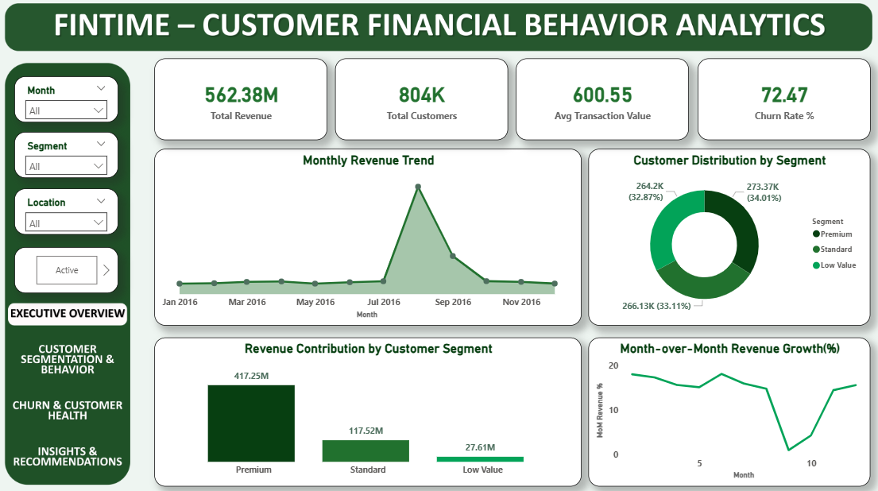
Executive Overview Dashboard
What this page shows
KPIs:
Visuals:
Business performance snapshot
Revenue & customer health
Trend visibility
Total Revenue
Total Customers
Avg Transaction Value
Churn Rate %
Monthly Revenue Trend (Area/Line)
Revenue Contribution by Segment (Bar)
Customer Distribution by Segment (Donut)

Slide 10
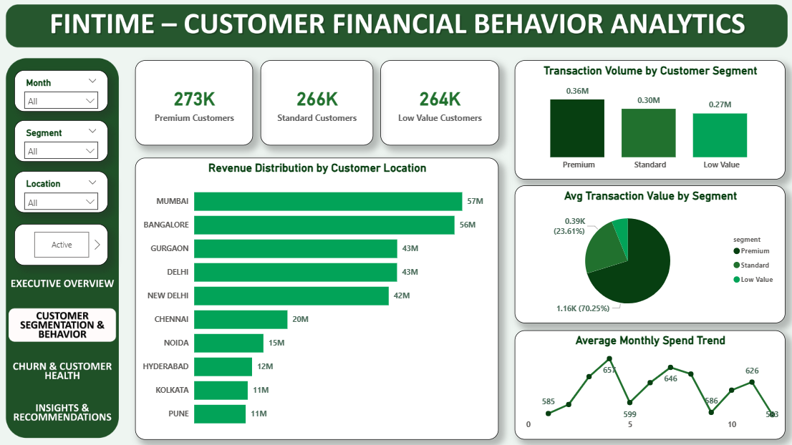
Customer Segmentation & Behavior
Purpose:
KPIs:
Visuals:
Understand who drives revenue and how customers behave
Premium Customers
Standard Customers
Low Value Customers
Revenue by Location (Horizontal Bar)
Transaction Volume by Segment (Bar)
Avg Transaction Value by Segment (Donut)
Average Monthly Spend Trend (Line)

Slide 11
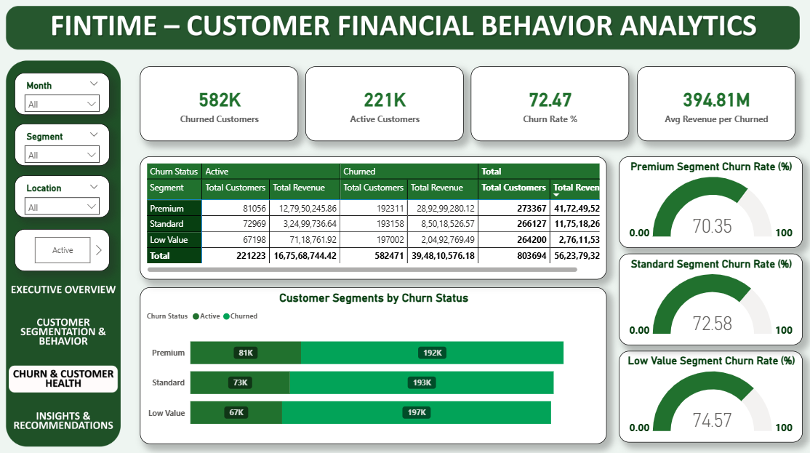
Churn & Customer Health Dashboard
Purpose:
KPIs:
Visuals:
Churned Customers
Active Customers
Churn Rate %
Avg Revenue per Churned Customer
Customer Segments by Churn Status (Stacked Bar)
Churn Rate by Segment (Gauge)
Churned Customers by Month (Line/Bar)
Churn Table (Segment-wise Revenue & Customers)
Detect churn risk and revenue exposure

Slide 12
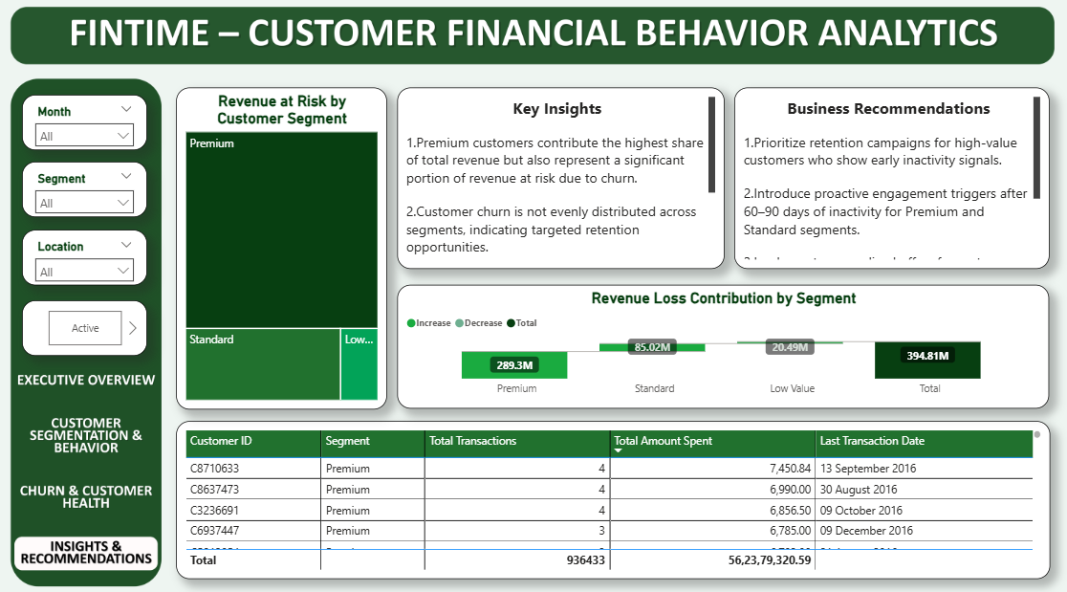
Revenue at Risk Analysis
What is Revenue at Risk?
Visuals:
Revenue at Risk by Segment (Treemap)
Revenue Loss Contribution (Waterfall)
Churned Customer Detail Table
Revenue generated by customers who have already churned — potential loss exposure

Slide 13
Key Insights
Business Insights
Premium customers generate maximum revenue but pose high risk
Standard segment shows highest churn probability
Strong seasonal revenue patterns
Peak transaction activity between 6–9 PM
Metro cities dominate revenue contribution

Slide 14
Strategic Recommendations
Loyalty programs for Premium customers
Retention campaigns for Standard segment
Peak-hour targeted marketing
Geo-focused expansion strategies
Seasonal promotion alignment
Predictive churn model (future)
Actionable Recommendations

Slide 15

ExpECTED IMPACT
Business Impact
15–20% churn reduction
18–25% revenue uplift
Improved campaign efficiency
Reduced revenue volatility

Slide 16
Power BI – Visualization & insights
GitHub – Version control & documentation
Excel - Data Understanding & Cleaning
TOOLS USED
Tech Stack

Slide 17


Why This Project Matters
FinTime demonstrates:
Real-world business thinking
Strong Excel + Power BI skills
End-to-end analytics workflow
Executive-level storytelling
Thank
You
https://github.com/manyajain1911/Customer-Financial-Behaviour-Analytics
manyajain005@gmail.com

